Slide 1
Applied Data Science Capstone ( Week5)

Slide 2
Overview COVID 19 Cases Analysis using County data in Texas
Extract All County Data from Wikipedia using requests python lib.
Visualize All County by Population
Download the Data from Texas COVID website and Analsis.

Slide 3
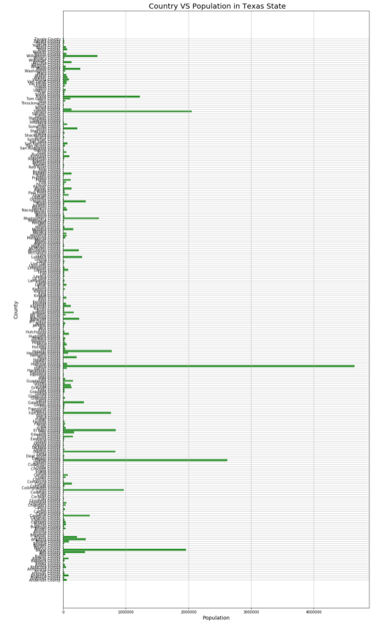

Slide 4
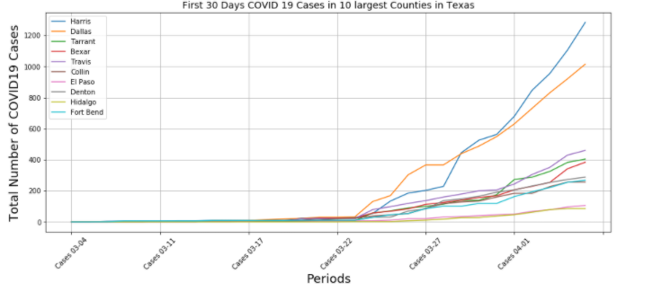
First 30 Days COVID 19 Cases in 10 largest Countries in Texas

Slide 5
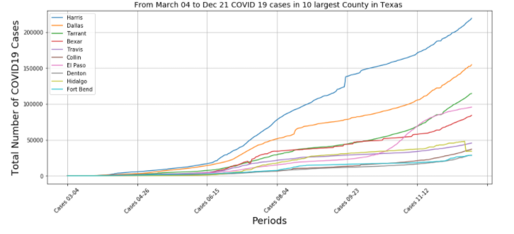
March 04 to Dec 21 COVID 19 cases in 10 largest Countries in Texas

Slide 6
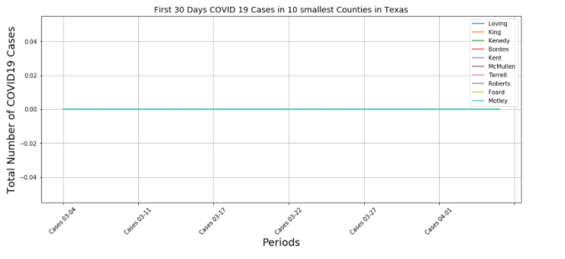
First 30 Days COVID 19 Cases in 10 smallest Countries in Texas

Slide 7
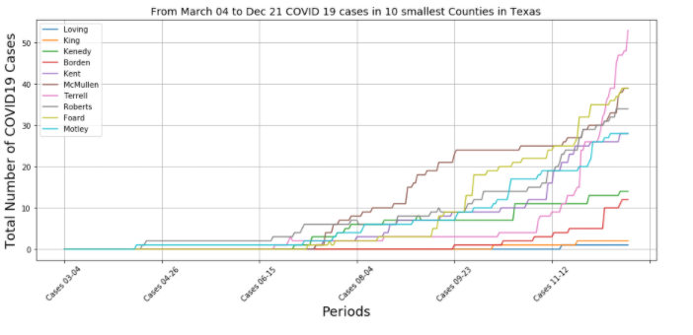
March 04 to Dec 21 COVID 19 cases in 10 smallest Countries in Texas

